Slide 1


Fleet Management system for NOLIMIT

Slide 2
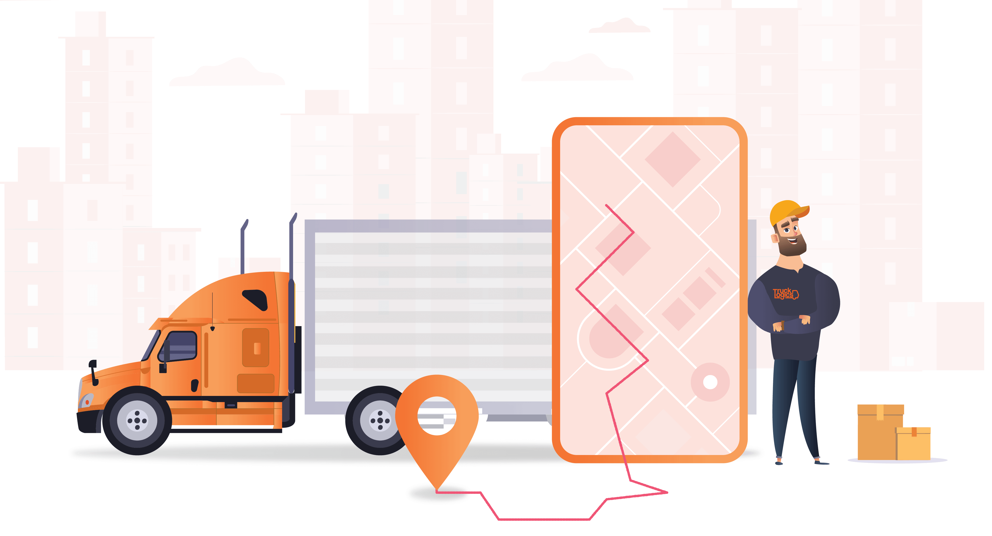
Introduction
NOLIMIT is a large retail fashion supply chain in Sri Lanka.
It has several departments for easy management of the business function.
Fleet Management Department is critical.
Currently functioning with a Manual system
Our proposed software will help to continue this
system easy & smart…

Slide 3

Understanding the current system
Main functions of the department are,
- collect and enter data
- assign drivers on demand
-generate monthly reports
- generate annual reports

Slide 4
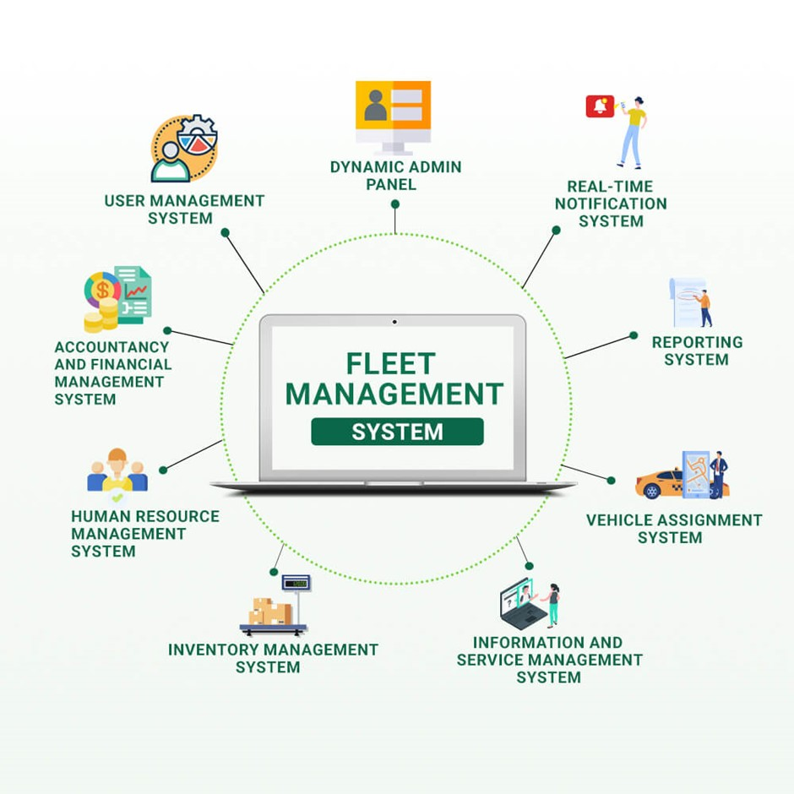
Benefits of Implementing the software
Will help to keep all physically collected data on a database.
Even Provided allocation, fuel request, vehicle request thorough the software.
Reduce the fuel consumption.
Managing the Allocation.
Vehicles & driver’s details handling.
Vehicle Maintenance details management.
Generate the reports.
Tracking the vehicles live.
Vehicle & fuel requests sending.
3

Slide 5
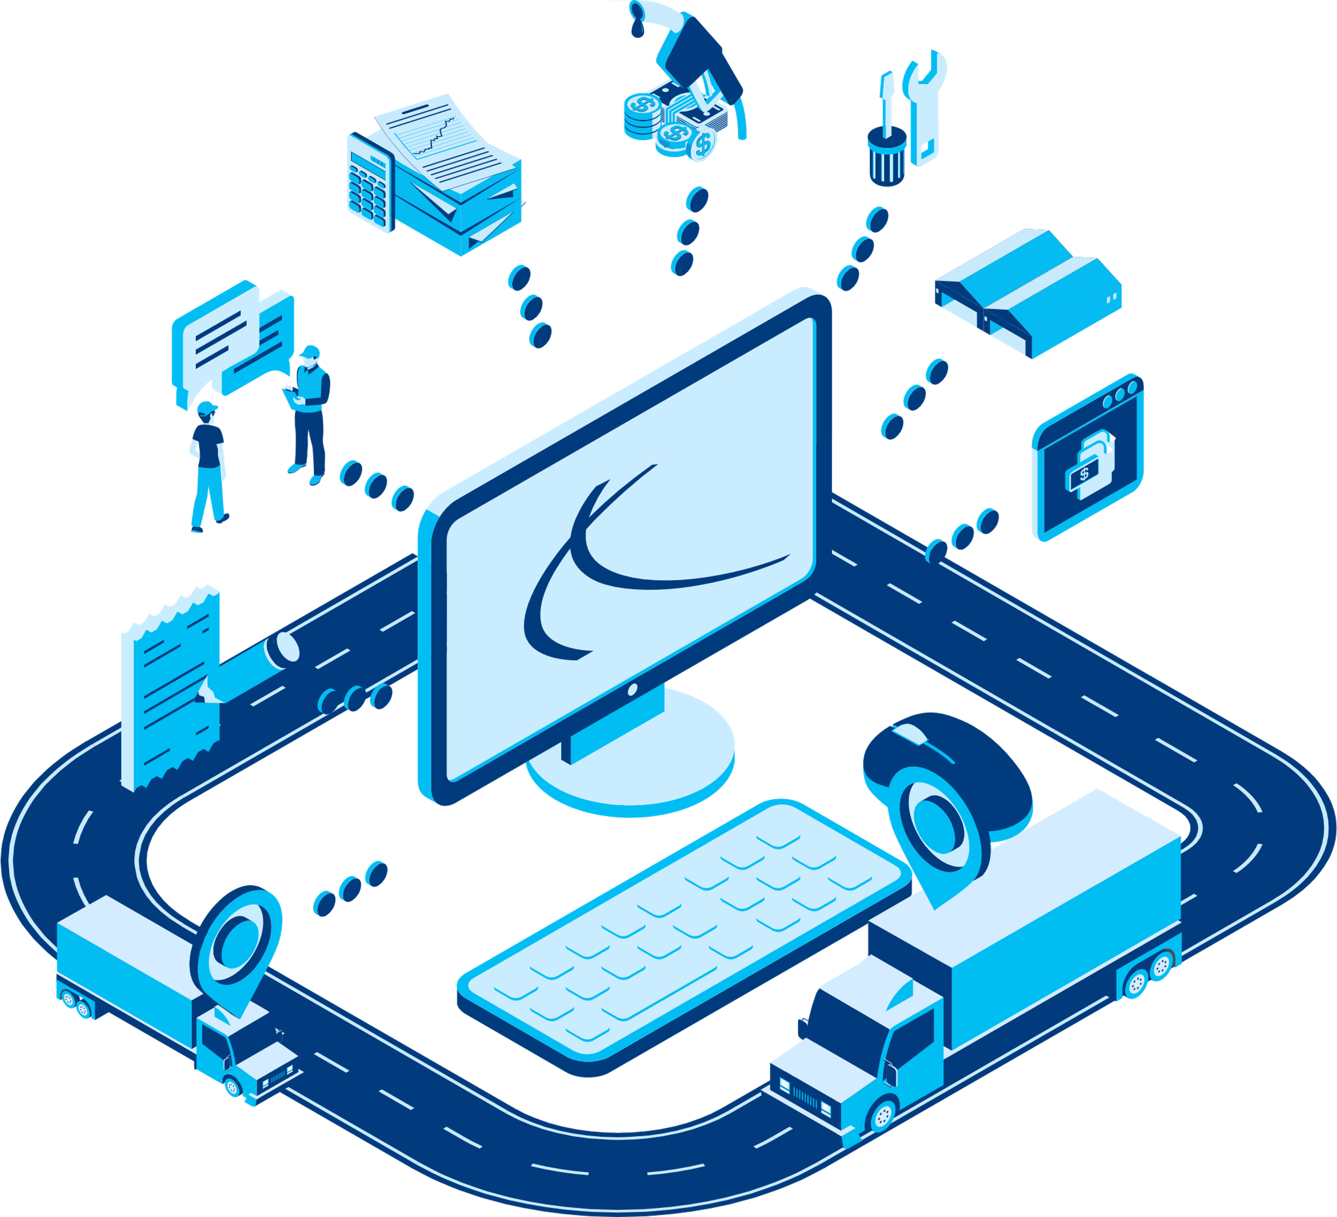

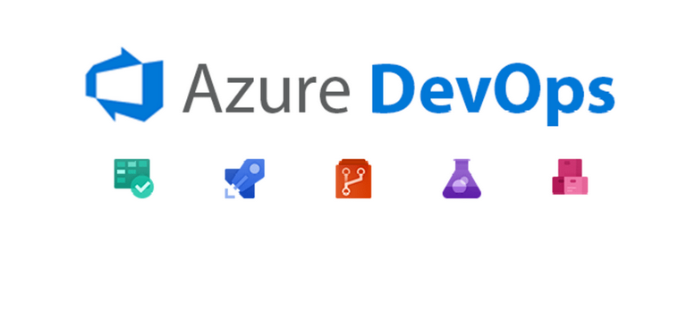
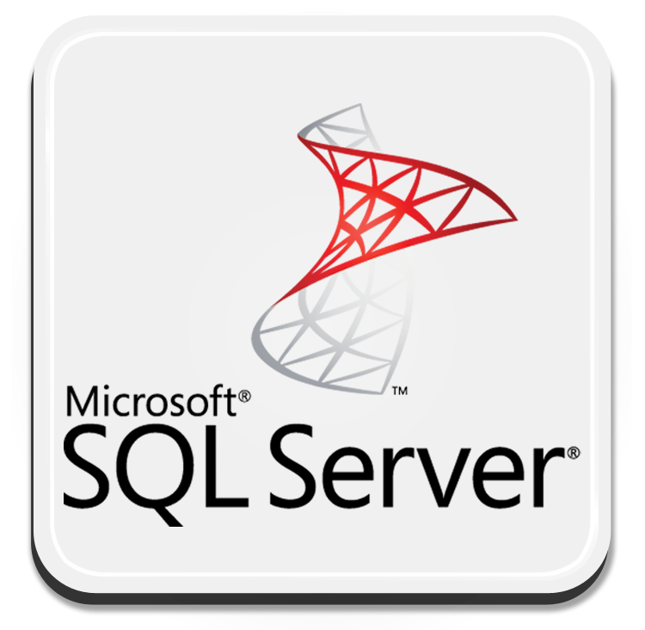


Technology in the software
1. C# programming Language & ASP.NET MVC Model Architecture
5. Azure DevOops
2. MSSQL Database
4. Figma Is UI editor
3. Visual studio is a IDE

Slide 6
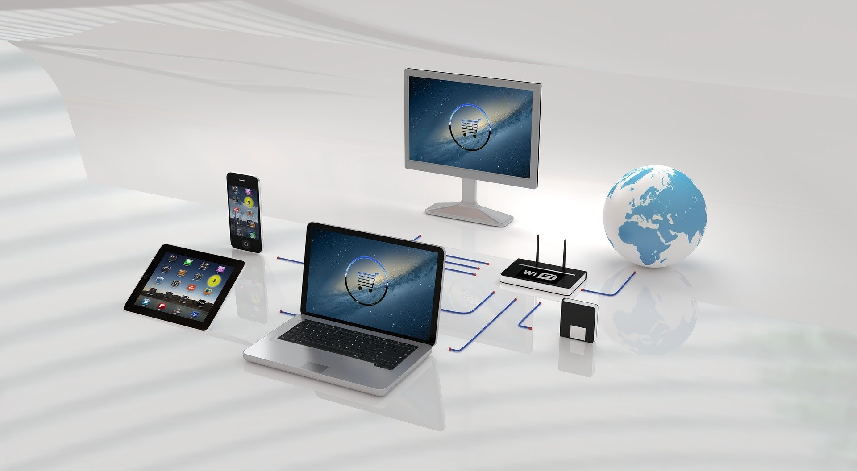
Best Practices for mastering the software
- Regularly review & update data…
- Stay proactive with vehicle maintenance…
- Provide ongoing training and support…
- Continuous analyze the system reports

Slide 7
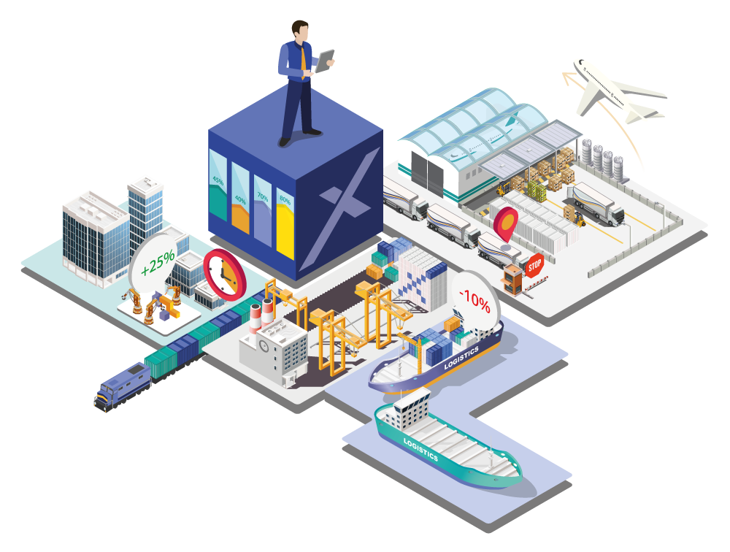
Overcoming Challenges...
Few challenges during project period…
Employee training.
potential system integration issues.
Technical issues.
Proper understanding & support can successfully
do it…

Slide 8
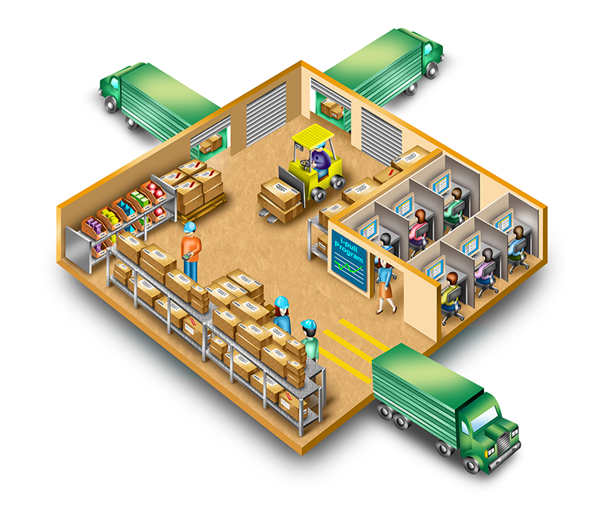
Conclusion…
Manual Fleet management System was a pain point for Nolimit.
Hence they wanted to convert it to a system.
Our team gathered information and found the culture & provide a solution as a software.
Successfully implemented the NOLIMIT Fleet system.

Slide 9
Thank You!

